Slide 1
Process coordination

Slide 2
How do we maximize CPU utilization / improve efficiency?
Multiprogramming
Multiprocessing

Slide 3
Concurrent operation
In uni-processor system Processes are interleaved in time
In multiprocessor system processes are overlapped

Slide 4
Interleaving
P1
P2
P3

Slide 5
Overlapping
P1
P2
P3

Slide 6
Concurrent operation
Interleaving and overlapping improves processing efficiency
Interleaved /overlapped process may produce unpredictable results if not controlled properly

Slide 7
Why Problem arises with Interleaving & overlapping
Finite resources
Relative speed of execution of processes can not be predicted
Sharing of resources(non shareable ) among processes
Sharing of memory is required for Inter process communication

Slide 8
Example
Procedure echo;
Var out,in:Character;
Begin
input (in, keyboard);
out:=in;
output(out,Display)
End

Slide 9
Process p1
input (in, keyboard);
------------------
------------------
------------------
out:=in;
output(out,Display)
Process P2
--------
input (in, keyboard);
out:=in;
output(out,Display)

Slide 10
Operating system concern
The result of a process must be independent of the speed at which the execution is carried out

Slide 11
We need to understand: How processes interact?
The problem is faced as system has several resources which are to be shared among the processes
In system we have processes which are
unaware of existence of other processes and such processes compete for resources
Processes indirectly aware of each other such processes exhibit cooperation
Processes directly aware of each other, show cooperation

Slide 12
When Processes compete for resources,the problem of deadlock , mutual exclusion and starvation may occur
When processes are directly aware of other processes, the problem of deadlock and starvation still might exist

Slide 13
Concurrency control problem
Mutual exclusion
Starvation
Deadlock

Slide 14
Cooperating & competing processes can cause problem when executed concurrently

Slide 15
How Processes cooperation is achieved ?
Shared Memory
Mutual exclusion
Message passing

Slide 16
Solution to critical section problem
Successful use of concurrency requires
Ability to define critical section
Enforce mutual exclusion
Any Solution to critical section problem must satisfy
Mutual exclusion
Progress : when no process in critical section, any process that makes a request for critical section is allowed to enter critical section without any delay
Processes requesting critical section should not be delayed indefinitely (no deadlock, starvation)
No assumption should be made about relative execution speed of processes or number of processes
A process remains inside critical section for a finite amount of time

Slide 17
Approach to handle Mutual Exclusion
Software Approach ( User is responsible for enforcing Mutual exclusion)
Hardware Support
Disabling of Interrupt
Special Instructions
OS support
Semaphore
Monitor

Slide 18
Software Approach ( Solution 1) Var turn :0..1;
Process 0
------
------
While turn <>0 do { nothing};
< Critical Section code >;
Turn := 1;
Process 1
------
------
While turn <>1 do { nothing};
< Critical Section code >;
Turn := 0;

Slide 19
This solution guarantees mutual exclusion
Drawback 1: processes must strictly alternate
Pace of execution of one process is determined by pace of execution of other processes
Drawback 2: if one processes fails other process is permanently blocked

Slide 20
This problem arises due to fact that it stores name of the process that may enter critical section rather than the process state

Slide 21
Second Approach Var flag:Array[0..1] of Boolean; initially flag is initialized to false
While flag[1] do {nop};
Flag[0]:= true;
< critical section>;
Flag[0]:= false;
--
--
While flag[0] do {nop};
Flag[1]:= true;
< critical section>;
Flag[1]:= false;
--
--

Slide 22
P2
While flag[0] do {nop};
Flag[1]:= true;
< critical section>;
Flag[1]:= false;
--
--
P1
While flag[1] do {nop};
Flag[0]:= true;
< critical section>;
Flag[0]:= false;
--
--

Slide 23
Second approach
If one process fails outside its critical section including the flag setting code then the other process is not blocked
It does not satisfy the Mutual exclusion
It is not independent of relative speed of process execution
Mutual exclusion is not satisfied as processes can change their state after it is checked by other process

Slide 24
Third approach
Flag[0]:= true;
While flag[1] do {nop};
< critical section>;
Flag[0]:= false;
--
--
Flag[1]:= true;
While flag[0] do {nop};
< critical section>;
Flag[1]:= false;
--
--

Slide 25
This approach Satisfy mutual exclusion
This approach may lead to dead lock
What is wrong with this implementation ?
A process sets its state without knowing the state of other. Dead lock occurs because each process can insist on its right to enter critical section
There is no opportunity to back off from this situation (discourtesies processes)

Slide 26
Fourth approach
Flag[0]:= true;
While flag[1] do
Begin
Flag [0]:=false;
<delay for short time>
Flag[0]:=true
End;
< critical section>;
Flag[0]:= false;
--
--
Flag[1]:= true;
While flag[0] do
Begin
Flag [1]:=false;
<delay for short time>
Flag[1]:=true
End;
< critical section>;
Flag[1]:= false;
--
--

Slide 27
Fifth Approach
Var flag:Array[0..1] of Boolean;
Turn: 0..1;
Procedure p0
Begin
Repeat
flag[0]:= true;
while flag[1] do if turn = 1then
begin
flag[0]:=false;
while turn=1 do {nothing};
flag[0]:=true
end;
< critical section >
Turn:=1;
Flag[0]:=false;
Forever
End;

Slide 28
Mutual Exclusion (Hardware Approach)
Process interleaving is mainly due to interrupts / system calls in the system.
Because of interrupts or system call, a running processes gets suspended and another process starts running which results into interleaved code execution.
Interleaving of processes is main cause due to which mutual exclusion is required

Slide 29
How do we prevent Interleaving ?
Interleaving can be prevented by disabling the interrupt in the uniprocessor system
Mutual exclusion by disabling interrupt
Repeat
< disable interrupt >;
< Critical Section >;
<enable Interrupt >;
< remainder section >
Forever.

Slide 30
Problem with Hardware Approach
Interrupt Disabling can degrade the system performance as it will loose ability to handle critical events which occur in the system
This approach is not suited for multiprocessor system

Slide 31
Special machine instruction
We find entry into critical section requires eligibility check and this check consists of several operation eg.
Flag[0]= true;
While flag[1] do {nothing}
We need instruction which can execute these operations in atomic manner.

Slide 32
Test & Set Instruction
Function testset (var i:integer):boolean;
Begin
if i=0 then
begin
i:=1;
testset:=true
end
Else testset:=false
End.

Slide 33
Mutual exclusion using testset
Const n;
Var lock; (Initialized to 0 in the beginning)
Procedure p(i:integer);
Begin
Repeat
Repeat { nothing } untill testset(lock);
< critical section >
lock:=0;
<remainder section >
forever
end;

Slide 34
Properties of machine instruction approach.
It is applicable to any number of processes
It can be used to support multiple critical section. Each critical section can be defined by its own variable
Busy waiting is employed
Starvation is possible
Dead lock is possible

Slide 35
Semaphore (OS Approach)
We can view semaphore as integer variable on which three operations are defined
Can be initialized to a non negative value
Decrement operation ( wait )if the value becomes negative then process executing wait is blocked
Increment operation ( Signal ) if the value is not positive then a process blocked by wait operation is unblocked
Other than these three operations, there is no way to inspect or manipulate semaphore

Slide 36
Mutual exclusion
Var s:semaphore; initialized to 1
Begin
wait (s);
< critical Section>;
signal (s)
End.

Slide 37
Var s,r: semaphore; s is initialized to 1& r is initialized to zero
Process P0
-
---
------
Begin
wait (s);
< critical Section>;
signal (r)
End.
Process P1
-
---
------
Begin
wait (r);
< critical Section>;
signal (s)
End.

Slide 38
Two Types of Semaphores
Counting semaphore – integer value can range over an unrestricted domain.
Binary semaphore – integer value can range only between 0 and 1;

Slide 39
Wait operation
Type semaphore =record
count: integer;
queue: List of processes
End;
Var s: semaphore;
Wait(s)
Begin
s.count:=s.count-1;
if s.count <0 then
begin
place the process in s.queue;
block this process
end;
end;

Slide 40
Signal operation
Signal(s):
s.count:=s.count+1
if s.count<= 0 then
Begin
remove a process from s.queue;
place this process on ready list
end;
Note:
S.count>= 0, s.count is number of processes that can execute wait(s) without blocking
S.count<=0, the magnitude of s.count is number of processes blocked waiting in s.queue

Slide 41
Binary semaphore
Type binarysemaphore =record
value: (0,1);
queue: List of processes
End;
S: binarysemaphore;
Waitb(s):
If s.value=1 then s.value=0
else begin
place this process in s.queue;
block this process
end;

Slide 42
Binary semaphore
signalb(s):
If s.queue is empty then s.value=1
else begin
remove a process from s.queue;
place this process in ready queue
end;

Slide 43
Mutual exclusion Example
Var s:semaphore;(Initialized to 1)
Begin
repeat
wait (s);
<critical section>
signal(s);
<remainder section>
forever

Slide 44
Dead lock
Deadlock – two or more processes are waiting indefinitely for an event that can be caused by only one of the waiting processes.
Let S and Q be two semaphores initialized to 1
P₀ P₁
wait(S); wait(Q);
wait(Q); wait(S);
signal(S); signal(Q);
signal(Q) signal(S);

Slide 45
Producer consumer problem
One or more producer are producing some items (data) and a single consumer is consuming these items one by one.
Consumer can not consume until producer has produced
While producer is producing, consumer can not consume and vice versa
We assume producer can produce as many items it wants (infinite buffer)

Slide 46
Var n:semaphore (:=0)
s:semaphore (:=1)
Producer:
Begin
repeat
produce;
wait(s)
append;
Signal(s);
signal (n);
forever
End;
Consumer:
Begin
repeat
wait(n);
wait(s);
take;
signal(s);
consume;
forever
End;

Slide 47
What happens if signal(s) and signal(n) in producer process is interchanged ?
This will have no effect as consumer must wait for both semaphore before proceeding
What if wait(n) and wait(s) are interchanged ?
If consumer enters the critical section when buffer is empty (n.count=0) then no producer can append to buffer and system is in deadlock.

Slide 48
Semaphore provide a powerful tool for enforcing Mutual exclusion and process coordination but it may be difficult to produce correct program by using semaphore
wait and signal operation are scattered throughout a program, it is difficult to see the overall effect of these operations on semaphores they affect.

Slide 49
Bounded buffer Var f,e,s :semaphore (:=0); (In the begning s=1,f=0,e=n)
Producer
Begin
repeat
produce;
wait (e)
wait(s)
append;
Signal(s);
signal (f);
forever
End;
Consumer
Begin
repeat
wait(f);
wait(s);
take;
signal(s);
signal (e);
consume;
forever
End;

Slide 50
Bounded-buffer
Shared data
#define BUFFER_SIZE 10
typedef struct {
. . .
} item;
item buffer[BUFFER_SIZE];
int in = 0;
int out = 0;
int counter = 0;

Slide 51
Bounded-buffer
Producer process
item nextProduced;
while (1) {
while (counter == BUFFER_SIZE)
; /* do nothing */
buffer[in] = nextProduced;
in = (in + 1) % BUFFER_SIZE;
counter++;
}

Slide 52
Bounded-buffer
Consumer process
item nextConsumed;
while (1) {
while (counter == 0)
; /* do nothing */
nextConsumed = buffer[out];
out = (out + 1) % BUFFER_SIZE;
counter--;
}

Slide 53
Bounded Buffer
The statements counter++; counter--; must be performed atomically.
Atomic operation means an operation that completes in its entirety without interruption.

Slide 54
Bounded Buffer
The statement “count++” may be implemented in machine language as: register1 = counter
register1 = register1 + 1 counter = register1
The statement “count--” may be implemented as: register2 = counter register2 = register2 – 1 counter = register2

Slide 55
Bounded Buffer
If both the producer and consumer attempt to update the buffer concurrently, the assembly language statements may get interleaved.
Interleaving depends upon how the producer and consumer processes are scheduled.

Slide 56
Bounded Buffer
Assume counter is initially 5. One interleaving of statements is: producer: register1 = counter (register1 = 5) producer: register1 = register1 + 1 (register1 = 6) consumer: register2 = counter (register2 = 5) consumer: register2 = register2 – 1 (register2 = 4) producer: counter = register1 (counter = 6) consumer: counter = register2 (counter = 4)
The value of count may be either 4 or 6, where the correct result should be 5.

Slide 57
Race Condition
Race condition: The situation where several processes access – and manipulate shared data concurrently. The final value of the shared data depends upon which process finishes last.
To prevent race conditions, concurrent processes must be synchronized.

Slide 58
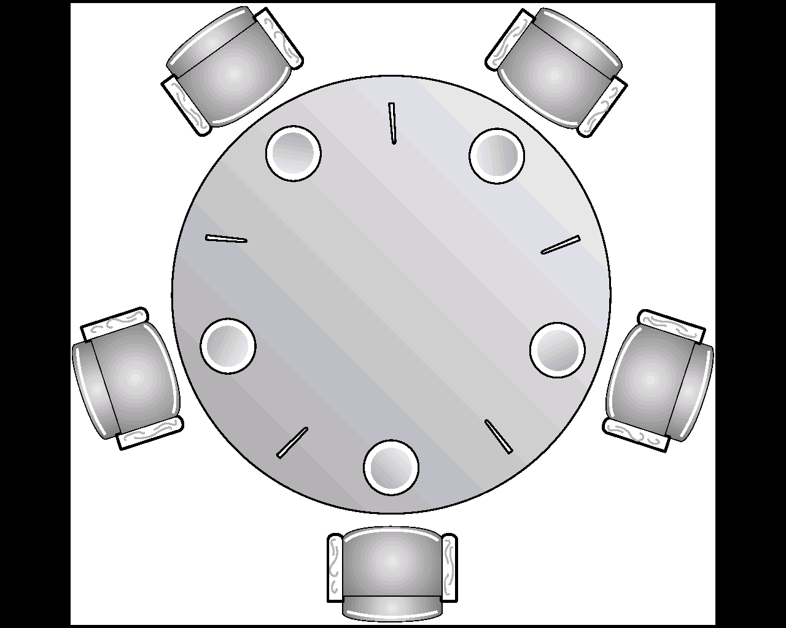
Dining-Philosophers Problem
Shared data chopstick[5]: semaphore; initially it is initialized to 1

Slide 59
To start eating, a philosopher needs two chopsticks
A philosopher may pick up only one chopstick at a time
After eating, the philosopher releases both the chopsticks

Slide 60
do {
wait(chopstick[i])
wait(chopstick[(i+1) % 5])
…
eat
…
signal(chopstick[i]);
signal(chopstick[(i+1) % 5]);
…
think
…
} while (1);

Slide 61
The solution is not deadlock free!!
All philosophers pick up left chopsticks!!
Allow at most 4 philosophers to be sitting on the table
Allow a philosopher to pick chopsticks only if both are available
An odd philosopher picks up first the left and then the right chopstick while a even philosopher does the reverse

Slide 62
Monitors
Monitor is a software module
Chief characteristics
➔Local data variables are accessible only by the monitor
➔Process enters monitor by invoking one of its procedures
➔Only one process may be executing in the monitor at a time

Slide 63
Monitor
High-level synchronization construct that allows the safe sharing of an abstract data type among concurrent processes.
type monitor-name = monitor
variable declarations
procedure entry P1 :(…);
begin … end;
procedure entry P2(…);
begin … end;

procedure entry Pn (…);
begin…end;
begin
initialization code
end

Slide 64
Monitor
To allow a process to wait within the monitor, a condition variable must be declared, as
var x, y: condition
Condition variable can only be used with the operations cwait and csignal.
➔The operation
cwait (x); means that the process invoking this operation is suspended until another process invokes
csignal (x);
➔The signal (x) operation resumes exactly one suspended process. If no process is suspended, then the signal operation has no effect.

Slide 65
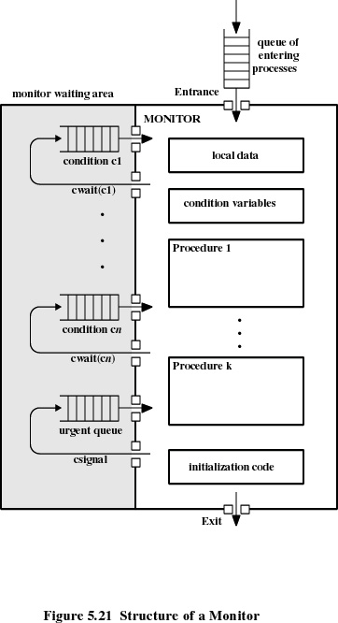

Slide 66
Monitor with signal
By enforcing discipline of one process at a time , monitor provide mutual exclusion
The data variable can be accesed by only on process at a time in the monitor
Shared data structure can be protected by placing it in monitor .

Slide 67
Producer/consumer
Monitor bounded-bufer
Buffer array [0..N] of char ;
in, out ,count :integer;
Full,empty :condition;
Procedure append(x:char);
Begin
If count = N then cwait(full) ;
Buffer[in]:=x;
in:= (in+1) mod N;
Count :=count +1;
csignal (empty)
End;
Procedure take(x:char);
Begin
If count =0 then cwait(empty);
x:=buffer[out];
out:=(out+1) mod N;
Count=count-1;
Csignal(full);
End
Begin
In=:=0;out:=0;count:=0;
End;

Slide 68
Procedure producer:
Var X char;
begin
repeat
produce(x)
append(x)
forever
end;
Procedure consumer;
Var x;
begin
repeat
take(x);
consume(x)
forever
end;

Slide 69
Monitor
A process exits the monitor immediately after executing the csignal
If process doing csignal is not done then two additional context switch is required
One to suspend this process
Resume when the monitor becomes available
Process scheduling should be reliable
When csignal is issued, the process from condition queue must get activated immediately

Slide 70
Allow the executing process to continue
Replace csignal with cnotify
Cnotify(x) : it causes x condition to be notified but allows the signaling process to continue
The signaled condition could get modified

Slide 71
Procedure append(x:char);
Begin
While count = N do cwait(full) ;
Buffer[in]:=x;
in:= (in+1) mod N;
Count :=count +1;
cnotify (empty)
End;
Procedure take(x:char);
Begin
While count =0 do cwait(empty);
x:=buffer[out];
out:=(out+1) mod N;
Count=count-1;
cnotify(full);
End

Slide 72
Interprocess Communication
Processes within a system may be independent or cooperating
Cooperating process can affect or be affected by other processes, including sharing data
Reasons for cooperating processes:
Information sharing
Computation speedup
Modularity
Convenience
Cooperating processes need interprocess communication (IPC)
Two models of IPC
Shared memory
Message passing

Slide 73
Communications Models
(a) Message passing. (b) shared memory.

Slide 74
Inter process Communication – Shared Memory
An area of memory is shared among the processes that wish to communicate
The communication is under the control of the users processes not the operating system.
Major issues is to provide mechanism that will allow the user processes to synchronize their actions when they access shared memory.
Some synchronization methods already discussed

Slide 75
Message Passing
The actual function of message passing is normally provided in the form of a pair of primitives:
send (destination, message)
receive (source, message)
Communication requires synchronization
Sender must send before receiver can receive
Sender and receiver may or may not be blocking (waiting for message)
Notes:
Emphasize that message-passing systems come in many forms. We provide a general introduction that discusses features typically found in such systems.
These primitives are a minimum set of operations needed for processes to engage in message passing.
A process sends information in the form of a message to another process designated by a destination.
A process receives information by executing the receive primitive, indicating the source and the message.

Slide 76
IPC synchronization
When send is executed :
Sending process can be blocked until message is received
it is allowed to proceed
When process issues a receive
If message has been previously sent, it receives
If there is no waiting message
The process is blocked until message is received
Process continues to execute abandoning the receive

Slide 77
Blocking send, Blocking receive
Both sender and receiver are blocked until message is delivered
Known as a rendezvous
Allows for tight synchronization between processes.

Slide 78
Non-blocking Send
More natural for many concurrent programming tasks.
Non blocking send, blocking receive
Sender continues on
Receiver is blocked until the requested message arrives
Non blocking send, non blocking receive
Neither party is required to wait
Notes:
Nonblocking send, blocking receive:
Although the sender may continue on, the receiver is blocked until the requested message arrives.
This is probably the most useful combination.
It allows a process to send one or more messages to a variety of destinations as quickly as possible.
A process that must receive a message before it can do useful work needs to be blocked until such a message arrives.
• Nonblocking send, nonblocking receive:
Neither party is required to wait.

Slide 79
Addressing
Sending process need to be able to specify which process should receive the message
Direct addressing
Indirect Addressing
Notes:
it is necessary to have a way of specifying in the send primitive which process is to receive the message.
Similarly, most implementations allow a receiving process to indicate the source of a message to be received.

Slide 80
Direct Addressing
Send primitive includes a specific identifier of the destination process
Receive primitive could handle in two ways
know ahead of time which process a message is expected and explicitly designate the sending process
Receive primitive could use source parameter to return a value when the receive operation has been performed

Slide 81
Indirect addressing
Messages are sent to a shared data structure consisting of queues
Queues are called mailboxes
One process sends a message to the mailbox and the other process picks up the message from the mailbox
Indirect addressing decouple the sender & receiver. It gives rise to
One to One , One to Many , Many to One and Many to Many relation ship
Notes:
A strength of the use of indirect addressing is that, by decoupling the sender and receiver, it allows for greater flexibility in the use of messages.

Slide 82
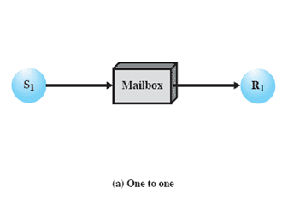
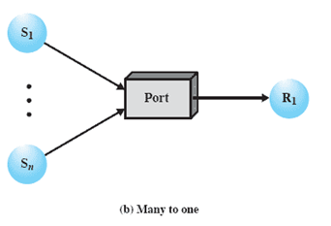
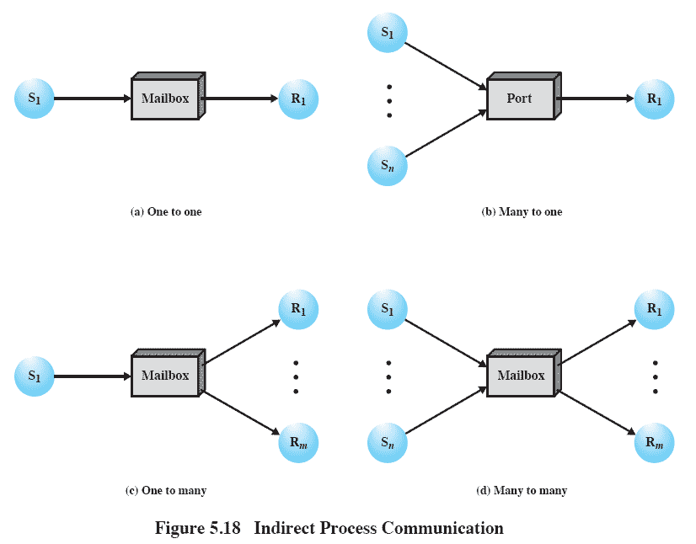
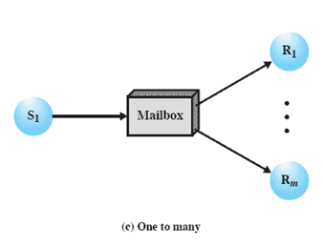
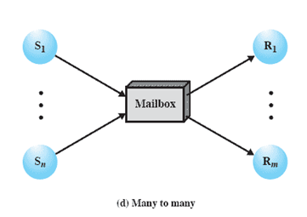
Indirect Process Communication
Notes:
Animated Slide – each item below is magnified for instructor to address separately
1) A one-to-one relationship
allows a private communications link to be set up between two processes.
This insulates their interaction from erroneous interference from other processes.
2) A many-to-one relationship is useful for client/server interaction;
one process provides service to a number of other processes.
In this case, the mailbox is often referred to as a port.
3) A one-to-many relationship allows for one sender and multiple receivers;
it is useful for applications where a message or some information is to be broadcast to a set of processes.
4) A many-to-many relationship
allows multiple server processes to provide concurrent service to multiple clients.
The association of processes to mailboxes can be either static or dynamic.
Ports are often statically associated with a particular process; that is, the port is created and assigned to the process permanently.
Similarly, a one-to-one relationship is typically defined statically and permanently. When there are many senders, the association of a sender to a mailbox may occur dynamically. Primitives such as connect and disconnect may be used for this purpose

Slide 83
One to one relationship
One to one relationship allows private communication link to be setup between sender and receiver
Many to one is useful for client server interaction.
One process provides service to number of other process
In this case mailbox is known as port
One to many : used for broadcast

Slide 84
Process –Mailbox association
Association of process to mailbox can be static or dynamic
Port is created and assigned to process permanently ( static association )
For one to one relationship, it is assigned permanently
When many senders are sending to mailbox, the association is dynamic
Connect, disconnect primitive are used for dynamic association

Slide 85
Ownership of mailbox
A port is typically owned and created by receiving process
When the process is destroyed, the port is also destroyed
For general mailbox, OS may offer a create mailbox service.
Such mailboxes are owned by creating process or OS

Slide 86
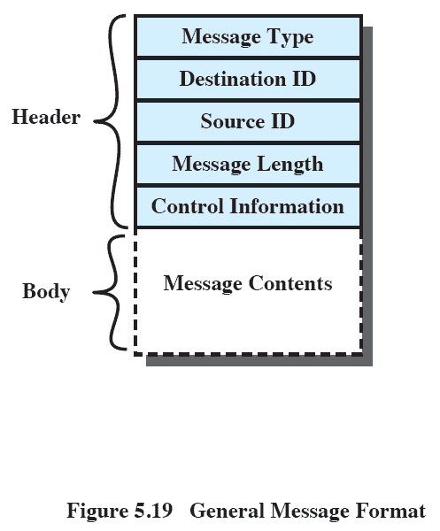
General Message Format
Notes:
The format of the message depends on the objectives of the messaging facility and whether the facility runs on a single computer or on a distributed system.
This is a typical message format for operating systems that support variable-length messages.
The message is divided into two parts:
a header, which contains information about the message.
The header may contain an identification of the source and intended destination of the message, a length field, and a type field to discriminate among various types of messages.
additional control information, e.g. pointer field so a linked list of messages can be created; a sequence number, to keep track of the number and order of messages passed between source and destination; and a priority field.
a body, which contains the actual contents of the message.

Slide 87
Mutual exclusion
We use blocking receive and non blocking send
Assume a mailbox named share1
All process can use mailbox for send & receive operation
The mailbox is initialized to contain a single message with null content
A process wishing to enter critical section attempts to receive a message. If the mailbox is empty then the process is blocked .
Once process has acquired message it enters the critical section, and on completion , places the message back in the mailbox
The message functions as a token that is passed from process to process. The process having the token enters the CS

Slide 88
receive (share1, msg)
<CS>
Send(share1,msg)
<remainder section>

Slide 89
Producer-Consumer
We use two mailboxes
Consume_1 .
It will contains items produced by the producer
As long there is one message, the consumer will be able to consume
Consume mailbox is serving as buffer . The data in buffer are organized as queue of messages
Produce_1
Initially mailbox produce_1 has number of null messages equal to size of buffer
The number of messages will shrink with each production and increase with each consumption

Slide 90
const capacity = ….
Null =…..
Var I; integer;
<parent process>
Begin
Create_mailbox (produce_1);
Create_mailbox (consume_1);
For i=1 to capicity send (produce_1, null);
Procedure producer;
Var pmsg :message;
Begin
While true do
begin
receive(produce_1,pmsg);
pmsg=produce ;
send(consume_1,pmsg);
end
End
Procedure consumer;
Var cmsg :message;
Begin
While true do
begin
receive(consume_1,cmsg);
consume(cmsg);
send(produce_1,null);
end
end

